Slide 1

Team 4
“SSDynamics”
Charles, Chas, Connor, Carter
Mentor: Savannah Chappus
Notes:
Charles
Use our logo colors

Slide 2



Client
Western Digital/Sandisk
Global storage company
12.13 billion market cap
Notes:
Explain how the business works and how it would go about testing/validating nvme ssds
Chas
SSD PCIe speeds has been rapidly growing, between the last two generations the speed have almost doubled.
This is a great thing for everyone. It means faster boot times for a computer and faster times program load times.
However, with each new generation there comes the challenges of developing new products.
There is a lot of development that is needed for each new SSD and along with that comes a lot of testing to make sure that the ssds are actually working properly.
Explain what is deficient about current testing/validation process
Charles D.
Talk about file management being faster.
This leads to faster file loading and saving.
Since SSDs are getting faster, this leads to less stability.
With this, there is a need for better and thorough testing.

Slide 3
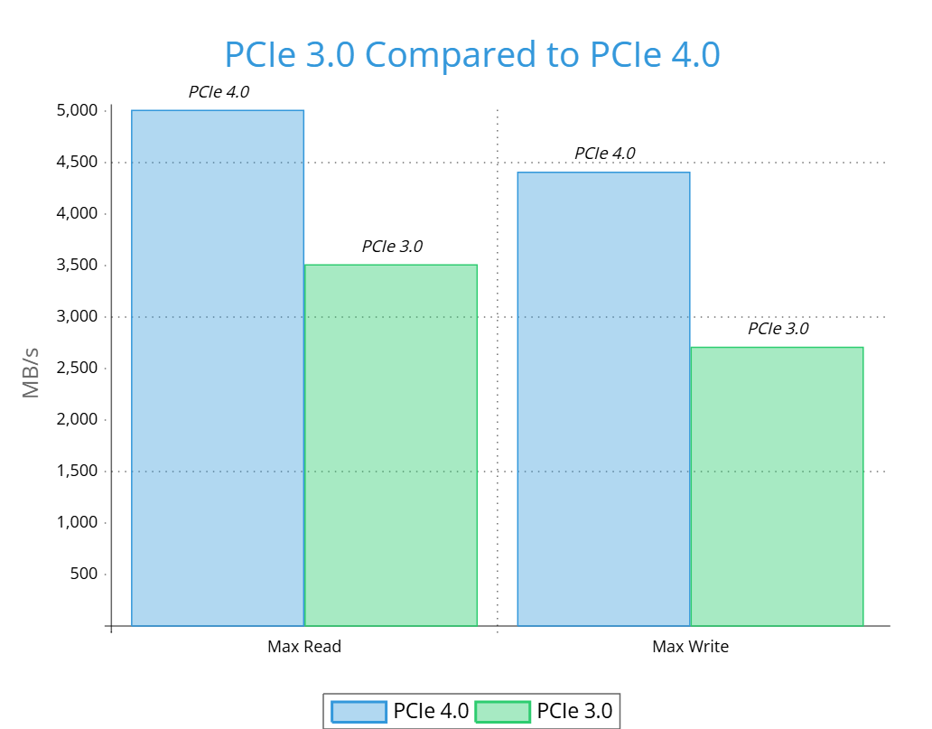
The Problem
3.0 PCIe -> 4.0PCIe
Boot Times affected
Faster load times for programs
Current Testing
SSDs are getting faster with each new generation.
Can lead to less stability.
Creates a need for better and thorough testing.
Notes:
Explain how the business works and how it would go about testing/validating nvme ssds
Chas
SSD PCIe speeds has been rapidly growing, between the last two generations the speed have almost doubled.
This is a great thing for everyone. It means faster boot times for a computer and faster times program load times.
However, with each new generation there comes the challenges of developing new products.
There is a lot of development that is needed for each new SSD and along with that comes a lot of testing to make sure that the ssds are actually working properly.
Explain what is deficient about current testing/validation process
Charles D.
Talk about file management being faster.
This leads to faster file loading and saving.
Since SSDs are getting faster, this leads to less stability.
With this, there is a need for better and thorough testing.

Slide 4
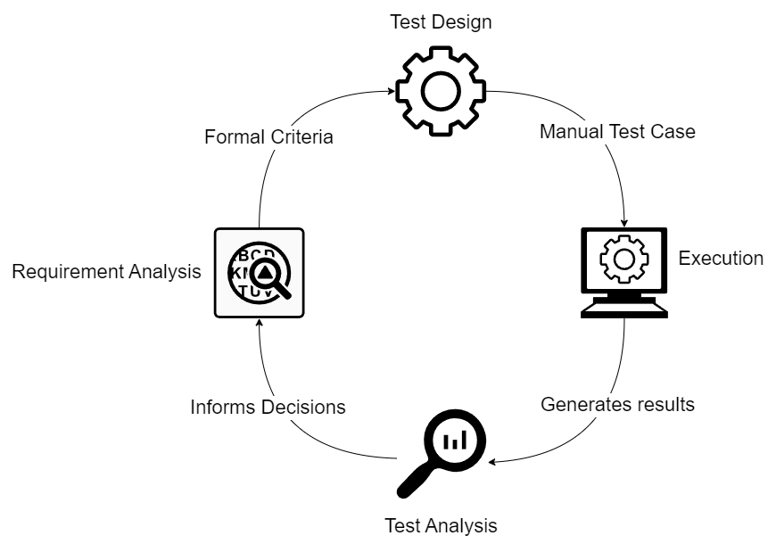
Notes:
This is the current testing workflow
individual testers use a test design, which includes the individual test cases and the expected output after the command is run.
an output is created after the command is run on the NVMe CLI which is analized by the tester.
this information is used to update the device if errors are found.
changes are then made to the test design if needed

Slide 5
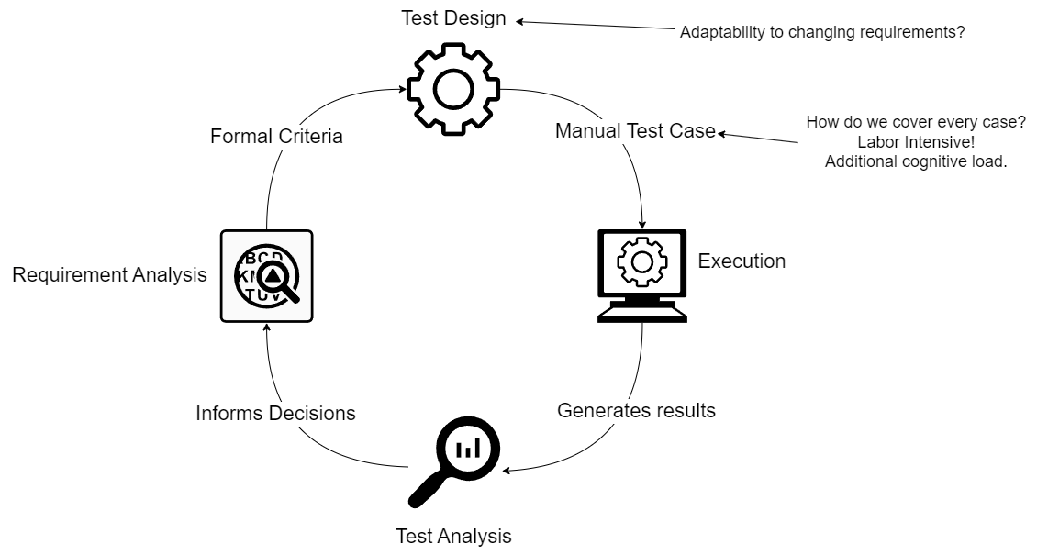
Notes:
problems with this method
test design is fixed during any given cycle, prevents adaptability in one testing iteration
tests are created manually and run individually. This is time consuming and edge cases are often missed

Slide 6
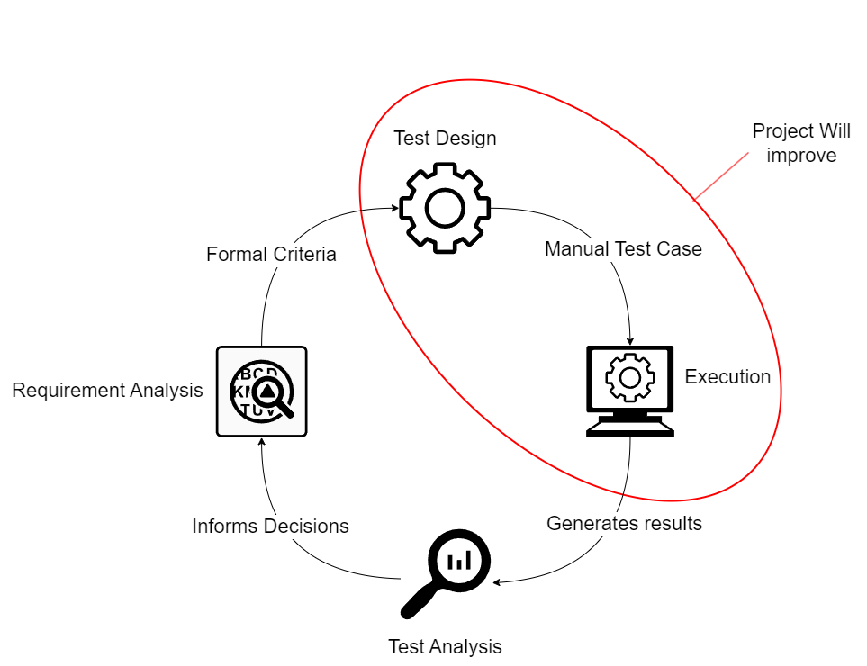
Notes:
our project will improve the test design, and execution phases of this testing cycle.

Slide 7
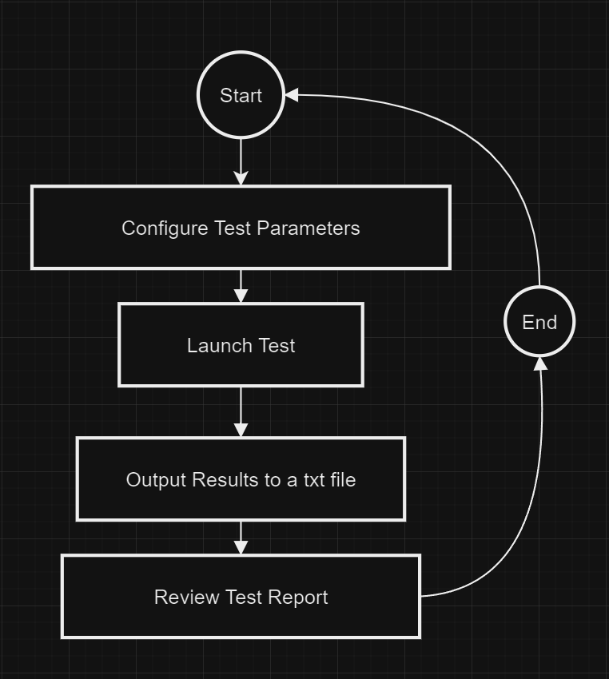
Our Solution
Generative testing
Generate or provide test key
Run that specific test case
Output result
Repeat!
Notes:
Carter:
in order to do this we will take a generative approach to ssd testing and validation
Our program will Generate a random test key or allow the user to provide their own. This allows for randomized and repeated tests, ensuing errors can be replicated and bugs have been removed
Each test will iterate through all possible states provided by the TLA+ file in the order according to the test key
using a Python translation file, the program will translate the TLA+ states and transitions into NVMe CLI Commands
the program will then execute these commands and send the output to a txt file for review by the tester
the result is a much more fault tolerant, and reliable product

Slide 8
Implementation Details
Functional Requirements
Must be able to call NVMe CLI commands through Python
Must be able to parse through TLA+ files in Python
Must be able to get logging information from NVMe-CLI commands
Randomise test keys for each command call
Implementation
TLA+ File
parser.py
nvme.py
logging.py
Notes:
Chas

Slide 9
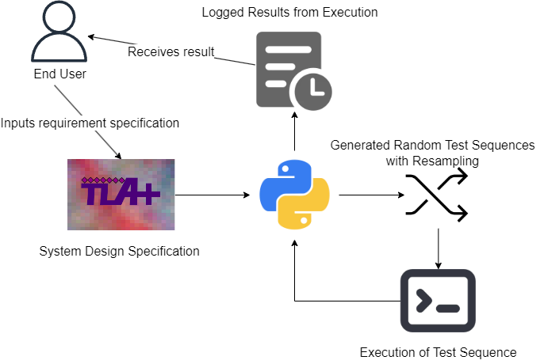
Notes:
add more detail to the implementation

Slide 10
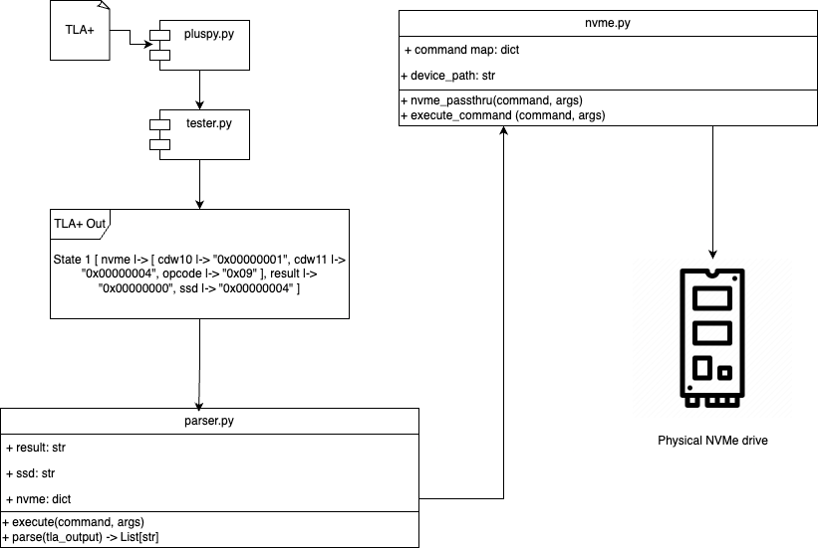
Implementation Details
TLA+ Parsing
Takes TLA+ output, deconstructs it into python variables and arguments
Notes special variables like result, nvme and ssd which changes how the simulator will submit commands
Sends final command to nvme.py
NVme-CLI command calls
Based on input command, decides whether to submit an admin or IO command
Uses system libraries to submit CLI commands
Notes:
connor

Slide 11
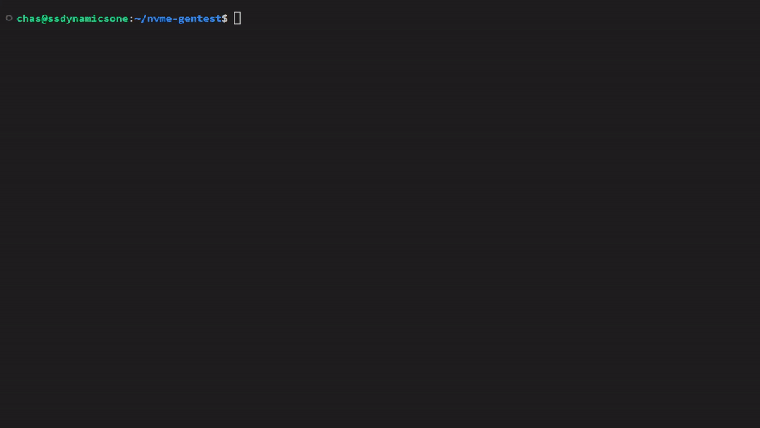
(Insert Project Prototype Demo)
*Live demo
Notes:
Chas

Slide 12
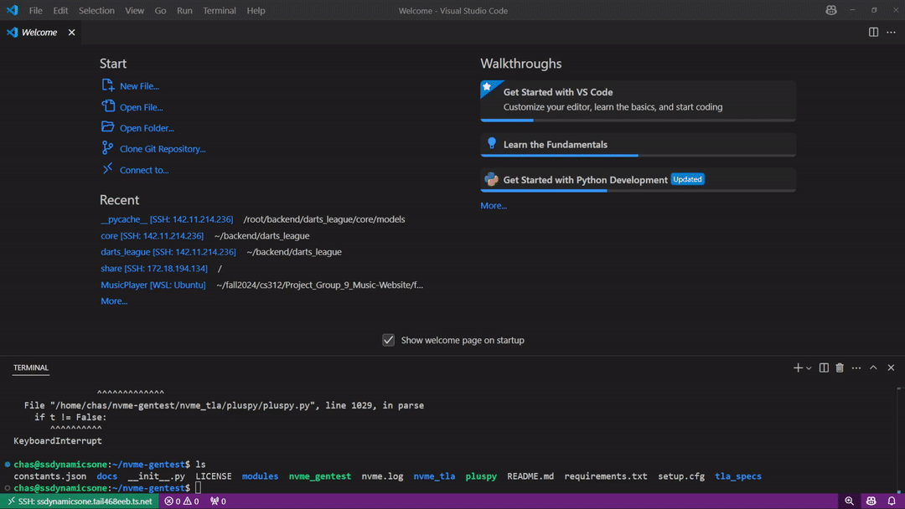
(Insert Project Prototype Demo)
*Live demo
Notes:
Chas

Slide 13
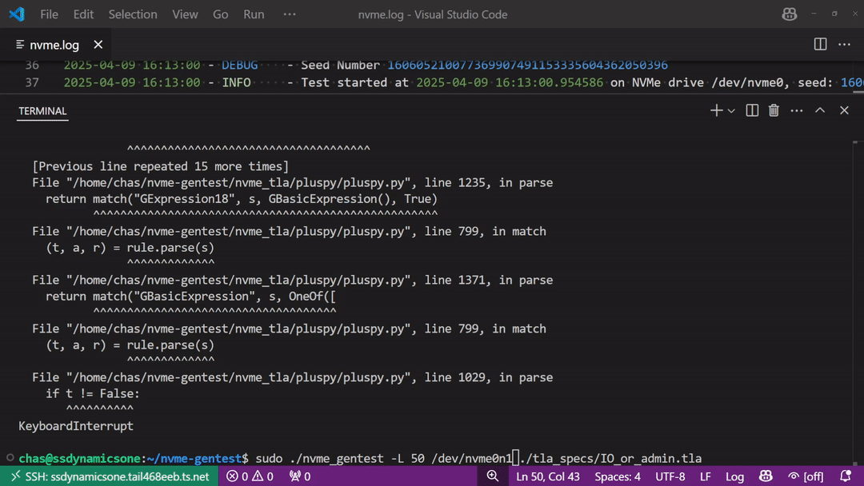
(Insert Project Prototype Demo)
*Live demo
Notes:
Chas

Slide 14
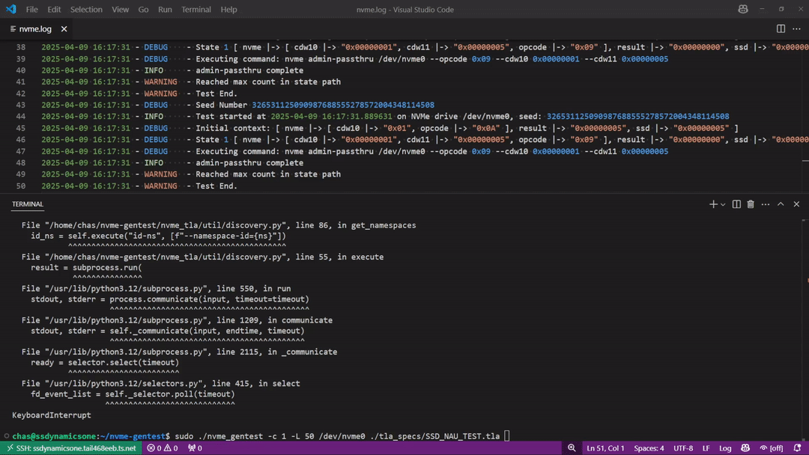
(Insert Project Prototype Demo)
*Live demo
Notes:
Chas

Slide 15
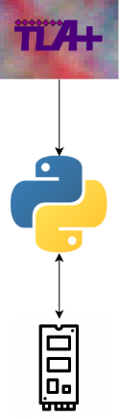
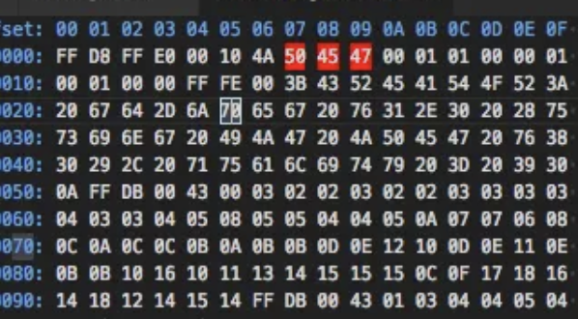
Challenges & Resolutions
Code
---------------------- MODULE TLA+ ----------------------
INIT == ^Mathematical In Nature
^Need complete understanding of the specific command being modeled
^Time and patience to understand and build specifications
How do we compare I/O hex dumps for patterns?
Async Calls
“Special” variables
  Way of passing external factors
  Must be extendable/modular
Notes:
Connor + Carter
Another set of difficulties come with TLA+
The main difficulty with TLA+ is its mathematical nature.
This leads to a very different way of thinking from how one would think when programming.
instead of following a singular flow, TLA+ creates a state graph that will be exhaustively searched, meaning all possible states in all possible orders will be explored to ensure the state graph has been thoroughly traversed.
Another challenge is that we need a complete understanding of the command being modeled, including the possible states.
this ensures that the entire command is modeled and all states are present so that the test is accurate to the real world.
the last challenge is that TLA+ requires a lot of time and patience to understand and build the TLA+ specification.
The NVMe specification spreads several documents and combined are over 900 pages of densely worded technical information.
Taking the time to thoroughly understand the specification of the commands we are implementing is required to re-create the commands in TLA+. This ensures they accurately represent the real world command

Slide 16
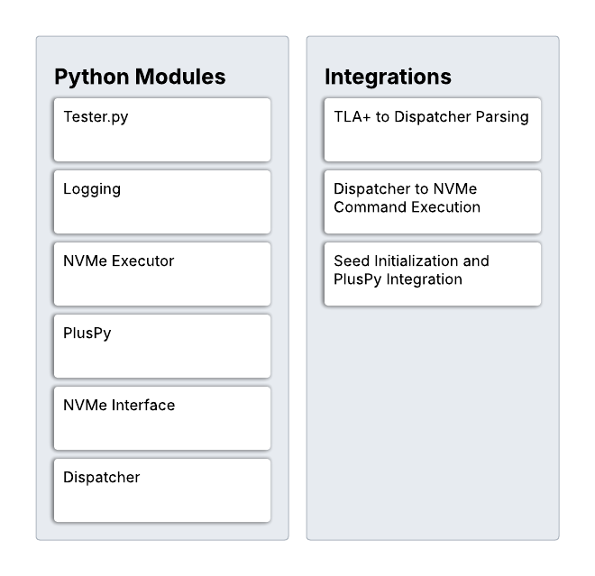
Testing Plan
Unit Testing
  Test each module
  Including our modified library
Integration Testing
  Test the module interactions
  Make sure they work as intended
Usability Testing
  Hand off the platform to the engineers to try out
  Get feedback from the engineer
Notes:
Charles

Slide 17
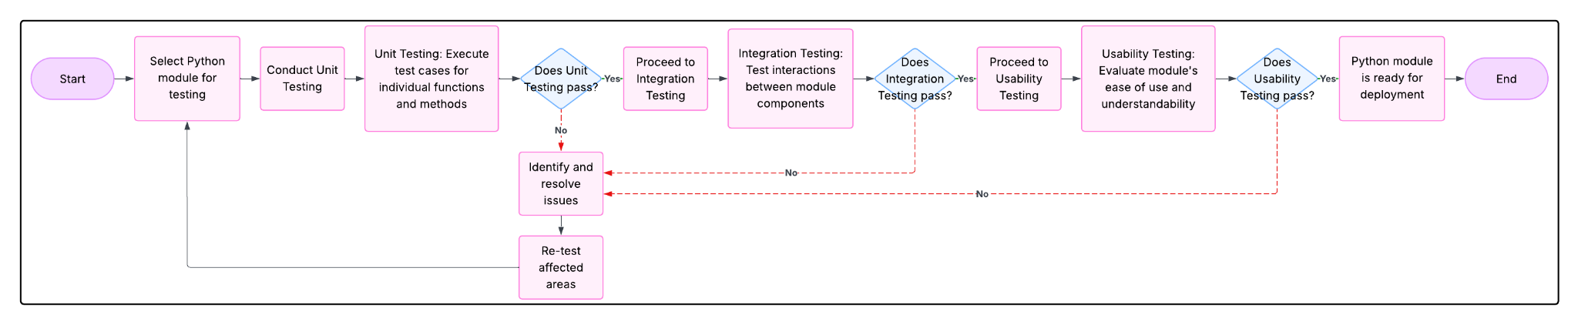
Testing Plan
Notes:
Charles

Slide 18
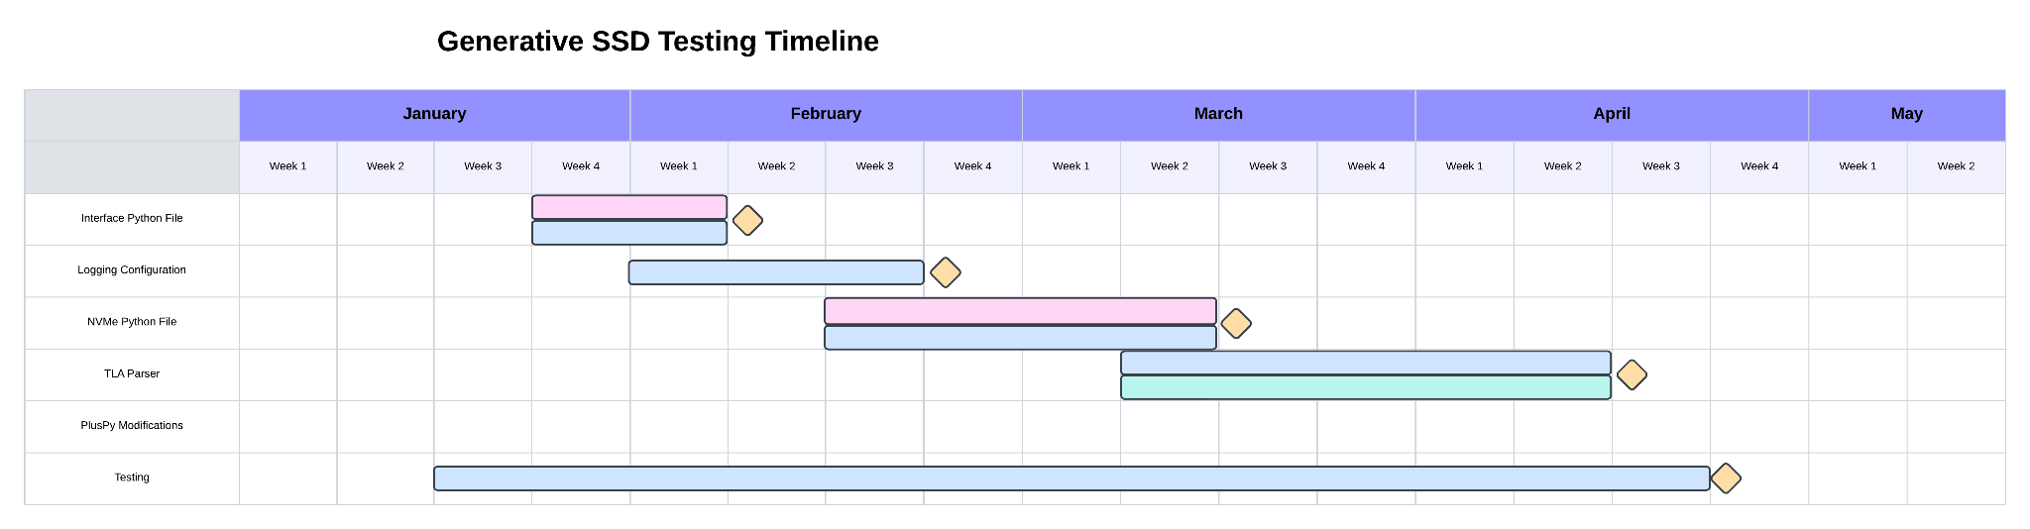
Schedule
Development Schedule
We’ve identified six different tasks to make happen for the rest of our project’s development timeframe. There are three different focuses based on the color, which is the kind of code we are going to write.
Notes:
Charles
So, to keep us on track when developing, we’ve come up with a development schedule…
Pink: NVMe-CLI focused
Blue: Python focused
Green: TLA+ focused
Tasks:
Interface Python File
Logging Configuration
NVMe & TLA Parser
Testing (Unit and Regression)
PlusPy Modifications
Testing will last throughout the entire project so that we can deliver a complete product to our client.

Slide 19
Conclusion
SSDs are getting faster
  This leads to a need for better testing.
Our solution explores every path for testing of an SSD’s functionality.
  This should help find weird niche bugs.
Our solution uses TLA+, Python, and NVMe-CLI
  We connect up each part, and log it’s output.
Notes:
Charles

Slide 20

Thank You!
Notes:
Charles?

